Slide 1

NEIL GOGTE INSTITUTE OF TECHNOLOGY
Advanced Machine Learning Project
SENTIMENT ANALYSIS FROM TEXT
By
Gangadar Chandu 2453-21-748-025
Pisupati Adithya 2453-21-748-111

Slide 2

INTRODUCTION
Sentiment Analysis, also known as opinion mining, is a subfield of Natural Language Processing (NLP) that focuses on identifying and categorizing opinions expressed in a piece of text.
This process determines the writer's attitude towards a particular topic, product, or service, classifying the sentiment as positive, negative, or neutral.
With the proliferation of social media and online reviews, sentiment analysis has become a crucial tool for businesses and researchers to understand public opinion and make data-driven decisions.
The objective of this mini project is to develop a sentiment analysis model that can automatically classify the sentiment of given text data.
This project will involve data collection, preprocessing, model training, evaluation, and deployment. By the end of the project, you will have a functional sentiment analysis tool that can be applied to various text data sources.

Slide 3
Packages
streamllib -- for web styling and represenations
NLTK -- for working with text like stop words
scikit-learn -- A machine learning library used for vectorization, model
training, prediction, and evaluation.
joblib -- For saving and loading the trained machine learning model
and vectorizer
Streamlit -- To create and deploy the web application interface for
sentiment analysis.

Slide 4
Algorithms Used
Naive Bayes Classifier (MultinomialNB)
Purpose: A probabilistic classifier based on applying Bayes' theorem with strong
(naive) independence assumptions between the features.
Usage: The core machine learning algorithm used for training the sentiment
analysis model.
TF-IDF Vectorization (TfidfVectorizer)
Purpose: To convert the text data into numerical feature vectors. TF-IDF stands for
Term Frequency-Inverse Document Frequency, a statistical measure used to
evaluate the importance of a word in a document relative to a collection of
documents (corpus).
Usage: For transforming the input text data into a form suitable for machine
learning models.

Slide 5
Execution Link
Running the app
http://localhost:8501/

Slide 6
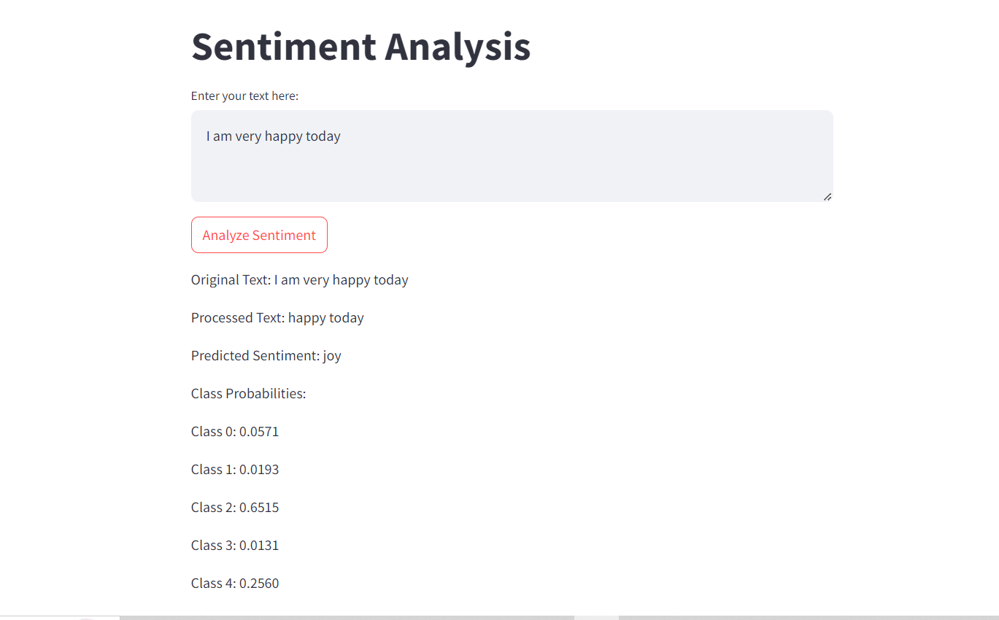
Output Screenshots (e.g matrix or plots)

Slide 7
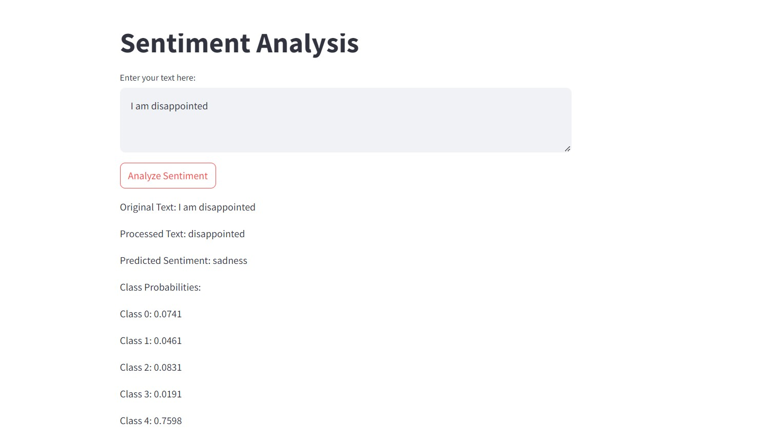
Output Screenshots (e.g matrix or plots)

Slide 8
Advantages
1. Real-Time Analysis:
->With the Streamlit app, users can get real-time sentiment analysis of text inputs,
which is useful for live monitoring and decision-making.
2. Improved Decision Making:
-> Businesses and individuals can make data-driven decisions based on the sentiment
analysis results, enhancing customer satisfaction and engagement strategies.
3. Customizable and Extensible:
-> The project is built using Python and popular libraries, making it easy to
customize and extend for specific use cases or to improve model accuracy.
4. Educational Value:
-> The project serves as a great learning opportunity for understanding natural
language processing (NLP), machine learning, and model deployment.

Slide 9
Disadvantages
1. Limited to Text Data:
-> The model can only analyze text data, which means it cannot be used forother
types of data like images or videos without significant modifications.
2. Accuracy Depends on Data Quality:
-> The accuracy of the model is highly dependent on the quality and
representativeness of the training data. Poor quality data can lead to
inaccurate predictions.
3. Handling Sarcasm and Nuances:
->Sentiment analysis models often struggle with detecting sarcasm, irony, and
nuanced expressions, which can lead to misclassification of sentiments.
4. Language and Domain Limitations:
->The model is trained on English text and may not perform well on texts in other
languages or from different domains without retraining on relevant datasets.

Slide 10
Use of Project
Customer Feedback Analysis:
o Businesses can analyze customer reviews, feedback, and survey responses to
understand customer satisfaction and identify areas for improvement.
2. Social Media Monitoring:
o Companies and organizations can monitor social media platforms to gauge
public opinion and sentiment about their brand, products, or services.
3. Market Research:
o Sentiment analysis can be used to analyze market trends and consumer
preferences by examining online discussions and reviews.
4. Product Improvement:
o By understanding the sentiment of customer feedback, companies can make
datadriven decisions to enhance product features and address customer pain
points.
5. Brand Reputation Management:
o Sentiment analysis helps in tracking and managing a brand’s reputation by
identifying positive or negative mentions and taking appropriate actions.

Slide 11
Conclusion
The sentiment analysis project leverages advanced natural language processing (NLP) and machine learning techniques to transform raw text data into actionable insights. By automating the process of sentiment detection, this project enables businesses and organizations to efficiently analyze large volumes of textual data, such as customer reviews, social media posts, and feedback forms. The model's ability to provide real-time sentiment analysis is particularly valuable for applications in customer feedback analysis, brand reputation management, and market research.
While the project offers significant advantages, such as scalability, automation, and improved decision-making, it also has limitations that need careful consideration. Issues such as handling nuanced expressions, ensuring data quality, and addressing potential biases must be managed to maximize the model's effectiveness and fairness.

Slide 12
Questions ??

Slide 13


